Slide 1
Computational Thinking, Problem Solving, and Programming
TOPIC 4.0 – Computational thinking
TOPIC 4
4.1.9 – 4.1.16: Thinking Ahead and Thinking Concurrently

Slide 2

REVIEW REVIEW REVIEW REVIEW REVIEW REVIEW
THE WARM-UP QUESTION
Create a pseudocode algorithm tell me what time of day it is
Assume a TIME variable already exists
Assume military time

Slide 3
TOPIC 4.1.4 – THINKING Logically
THE WARM-UP QUESTION
//Assume variable TIME already exists
if TIME > 5 and TIME < 12 then
output “It is morning”
else if TIME > 12 and TIME < 18 then
output “It is afternoon”
else if TIME > 18 and TIME < 22 then
output “It is evening”
else
output “It is night”

Slide 4
TOPIC 4.1.9 – THINKING AHEAD
INPUT AND OUTPUT
We want to make algorithms that can be used with a variety of different values
Formulas wouldn’t be useful if they only worked with one number
We include input for our algorithms to change what they do with different input

Slide 5
TOPIC 4.1.9 – THINKING AHEAD
INPUT AND OUTPUT
If employees earn a 30% bonus for working with a company for 9 months, and a 20% bonus otherwise…
SALARY = input(“What’s your salary?”)
MONTHS = input(“How long have you worked here?”)
BONUS = 0
if MONTHS >= 9 then
BONUS = SALARY * 0.3
else
BONUS = SALARY * 0.2
output BONUS
Now we have a super simple bonus calculator algorithm!
(Starting to look like a program that might actually be useful, eh?)

Slide 6
TOPIC 4.1.9 – THINKING AHEAD
INPUT AND OUTPUT
Our output is simply the values given back by our algorithm
If I write an algorithm to calculate the result of a math statement, the final number would be our output
Not every algorithm has input or output, but most do
This makes algorithms useful
We give them the data to modify as input
We then take the modified data as output

Slide 7
TOPIC 4.1.9 – THINKING AHEAD
INPUT AND OUTPUT
Input
Revolutionary Diagram
Our Algorithm
Output

Slide 8
TOPIC 4.1.9 – THINKING AHEAD
INPUT AND OUTPUT
Make some pseudocode algorithms to do the following:
Calculate Density
Average Three Numbers

Slide 9


TOPIC 4.1.10 – THINKING AHEAD
Pre-planning
Think about going to a library, and finding a book
Generally sorted by Genre, then Author’s name
You can find books rather quickly
Think about going to a library with UNSORTED books
Looking at every single book to find the right one
Would take forever
The library is sorted, which makes it a lot easier to find our books
Look at through algorithm perspective
The Library is pre-planned for our book finding algorithm

Slide 10
TOPIC 4.1.10 – THINKING AHEAD
Pre-planning
Our typical book finding algorithm
Locate genre section
Locate section of author’s last initial
Thumb through books
Find correct book
This works only when the library is pre-planned
Otherwise, if I’m unlucky, I have to check every book

Slide 11
TOPIC 4.1.10 – THINKING AHEAD
Pre-planning
Algorithms can require sorted data for efficiency
Can rely on other algorithms to keep data prepared
Algorithms may need to check if the data exists before it works with it
Check if I have this program installed before using it

Slide 12
TOPIC 4.1.11 – THINKING AHEAD
PRE-CONDITIONS
Having our data sorted is one example of a pre-condition
Anything that needs to be in place before our algorithm can go wild
If cooking, all ingredients and appliances must be present
When driving, you must have a car to drive
If you’re going to calculate payroll you must have employees and money

Slide 13


TOPIC 4.1.12 – THINKING AHEAD
POST-CONDITIONS
For an algorithm’s output to be valuable, you must also check for post-conditions
Example Algorithm
Check if all ingredients are present to make a cake (pre-condition)
PrepareCake()
Check for dining table (post-condition)

Slide 14
TOPIC 4.1.13 – THINKING AHEAD
EXCEPTIONS
When designing an algorithm, you watch for exceptions
Easiest example: an algorithm that divides two numbers
X = input(“type a number”)
Y = input(“type a number”)
Z = X / Y
output Z
Can somebody tell me what a possible problem is that could happen with this algorithm?

Slide 15
TOPIC 4.1.13 – THINKING AHEAD
EXCEPTIONS
If the input given sets Y = 0, we’d be dividing by zero!
We must check on this exception to make sure our algorithm will not fail
X = input(“type a number”)
Y = input(“type a number”)
if Y = 0 then
output “cannot divide by zero”
else
Z = X / Y
output Z
end if

Slide 16
TOPIC 4.1.13 – THINKING AHEAD
EXCEPTIONS
Make sure your algorithm doesn’t
Start without resources it didn’t check it had
Ingredients, programs, you name it!
Try to do something impossible
Divide by zero
Infinitely loop
We’ll talk more about this later (remember finiteness)

Slide 17
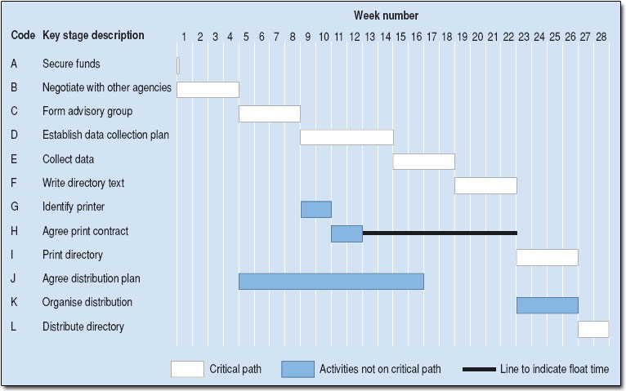
TOPIC 4.1.10 – THINKING AHEAD
Gantt Charts
Tangentially related to thinking ahead, let’s talk about planning!
Gantt Charts are used to schedule out projects
With overlap of tasks

Slide 18
TOPIC 4.1.14 – THINKING CONCURRENTLY
CONCURRENCY
Concurrent tasks can run in unison
I can walk and chew bubble gum at the same time
Concurrency in algorithms means a machine can do two different algorithms at once
Computer must have multiple processors
Computer may also switch between algorithms but uh that’s not really concurrent
All modern computers have multiple cores to allow for this
If something isn’t concurrent it’s sequential

Slide 19
TOPIC 4.1.15 – THINKING CONCURRENTLY
CONCURRENCY
The real world is full of concurrency
You’re breathing, thinking, reading, listening, and taking notes all at the same time
Even beyond that, trying to build a house without concurrency
Only ONE person can work on ONE part of the house at a time
You can cook the pasta and the sauce at the same time
Concurrency is sick and you can’t convince me otherwise

Slide 20
TOPIC 4.1.16 – THINKING CONCURRENTLY
CONCURRENCY
Making intentionally concurrent programs is pretty difficult
By no means impossible
Lots of games do it to great effect
Lots of frameworks (app engines) do it automatically
We will talk more about this later
Windows lets you run as many programs at once as you want
If I want to edit a Google Doc at the same time as my friend
Server concurrently runs both of our algorithms at once

Slide 21
TOPIC 4.1.15 – THINKING CONCURRENTLY
CONCURRENCY
Identify parts of an algorithm that can be run concurrently
Algorithm:
Get ingredients to make spaghetti
PrepareSpaghetti()
PrepareSauce()
PlateSpaghettiAndSauce()
Serve the dish
Which two steps could likely be run concurrently?

Slide 22
TOPIC 4.1.15 – THINKING CONCURRENTLY
CONCURRENCY
Identify parts of an algorithm that can be run concurrently
Algorithm:
Wash first load of laundry in washing machine
Dry first load of laundry in dryer
Wash second load of laundry in washing machine
Dry second load of laundry in dryer
Which two steps could likely be run concurrently?

Slide 23

TOPIC 4.1.7 – THINKING Logically
VOCAB TO REMEMBER
Input
Output
Pre-planning
Pre-condition
Post-condition
Concurrency
Exceptions
Gannt Chart

